Slide 1
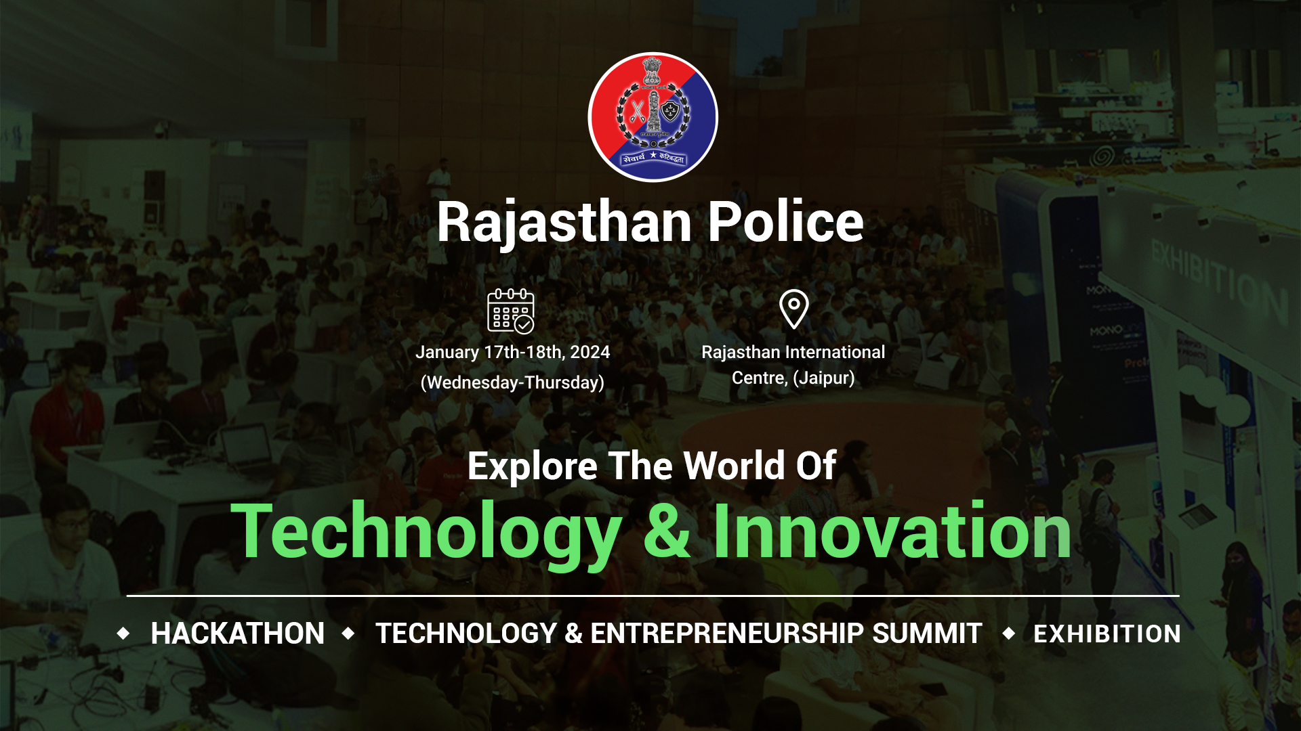

Slide 2
Registration ID - 1611 Team name - Golden Crown Team members M. Thrisha B. Deepak Kumar G. Akhila K. Ananya
Representing - CMR College of Engineering and Technology

Slide 3
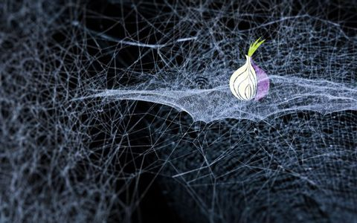
Problem statement – 11 DARK WEB MONITORING

Slide 4

PROBLEM STATEMENT
Develop an advanced Dark Web monitoring tool.
Simple interface with immediate Proxy connection.
Collection onion links from different search engines like Ahmia, Onion search.
Monitoring the onion links.

Slide 5

WHAT IS DARK WEB ?
The dark web is a subset of the deep web, which is not indexed by traditional search engines.
Dark web is intentionally designed to provide anonymity to users, making it a hub for various illicit activities.
Dark Web Monitoring is a critical and proactive approach to observing and analyzing activities within the dark web.

Slide 6
OUR OBJECTIVES
The research objectives for the Dark Web Monitoring project encompass the identification and analysis of threats within the dark web.
Identification and Analysis of Threats
Stolen data detection
Protect organization’s reputation
Web Scraping Techniques
User Interface Usability

Slide 7

PROPOSED SOLUTION
The proposed solution for the Dark Web Monitoring project involves several steps:
Secure Connection to Tor Network
Keyword-Driven Search Engine
Ahmia Browser Integration
Results Storage and Organization
Data Cleaning Module
Active Link Analysis Module
Data Extraction from Active Links
Cryptocurrency Link Analysis Module
User-Friendly Interface

Slide 8
BLOCK DIAGRAM
TOR Connection
Keyword Search
Results Storage
Data Cleaning
Active link analysis
Cryptocurrency link analysis
Data Extraction
Details such as Telegram id’s, emails

Slide 9
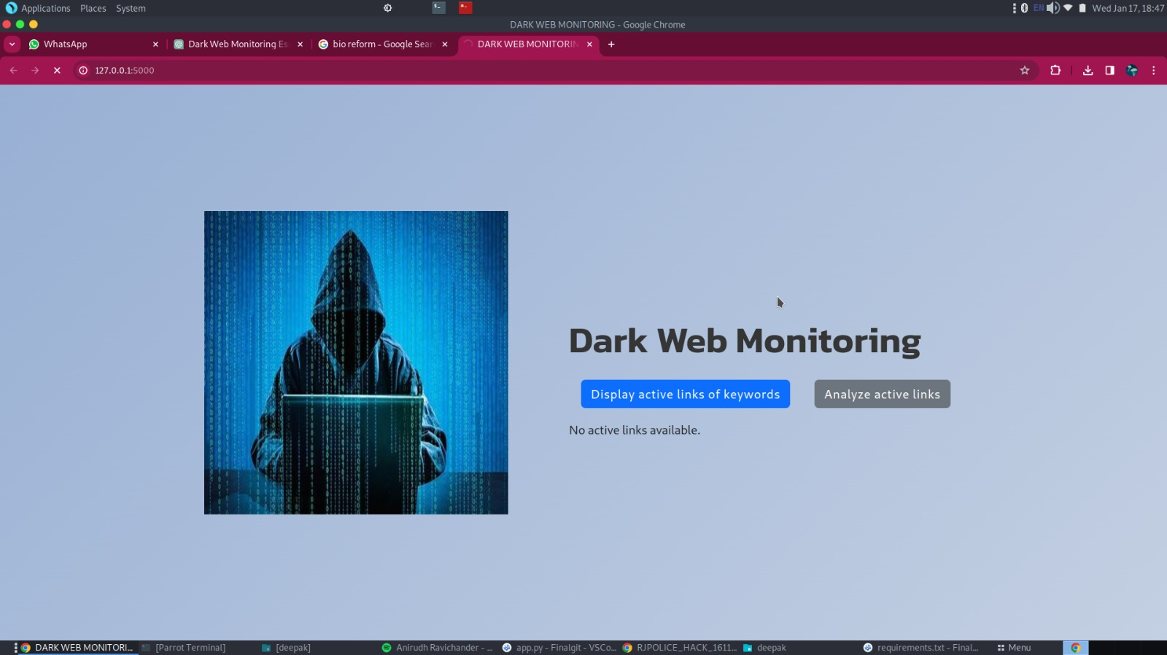
User Interface

Slide 10
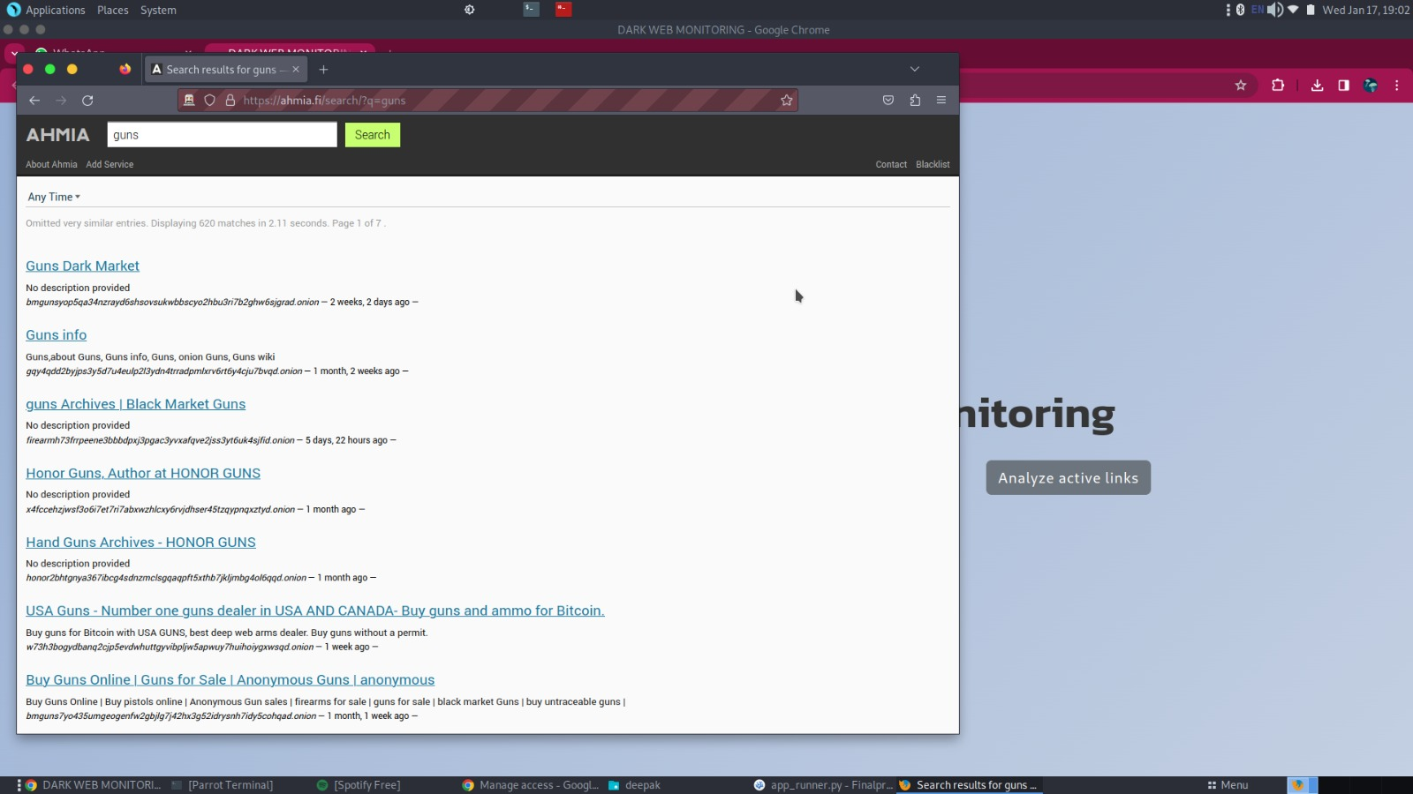
Keyword Search

Slide 11
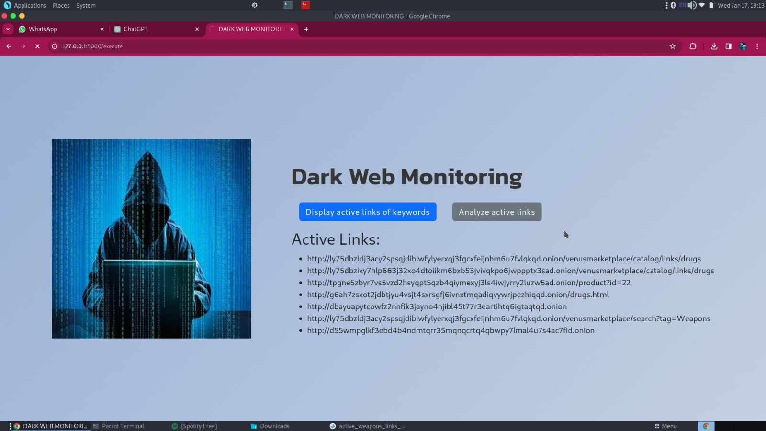
Displaying Active links of all keywords

Slide 12
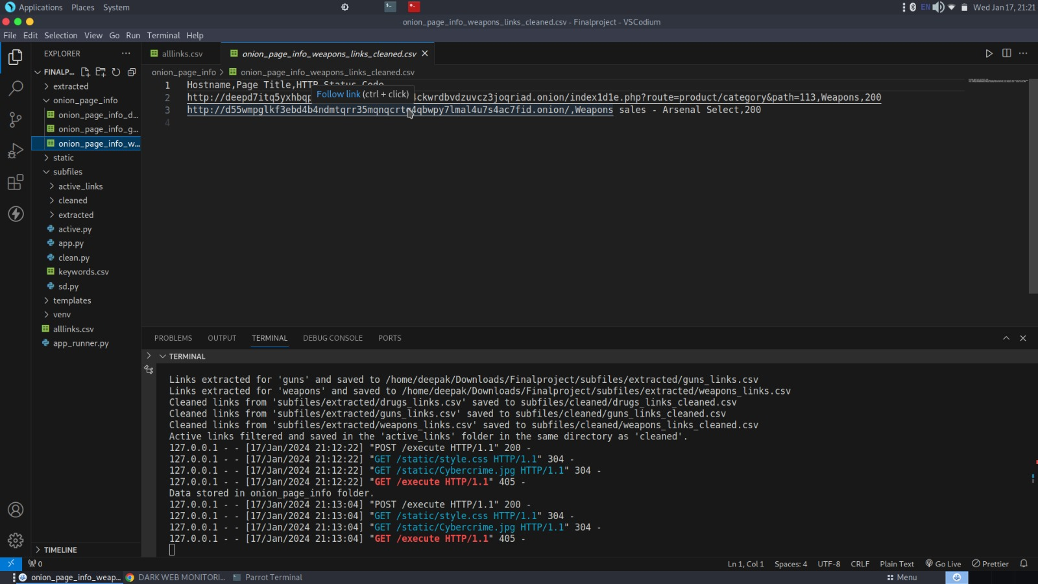
Website Information

Slide 13
CONCLUSION
The Dark Web Monitoring project successfully addresses the challenges posed by the clandestine activities on the dark web through the development of a robust toolset.
By achieving objectives such as proactive surveillance, cryptocurrency analysis, and user empowerment.
The systematic approach to data handling, ethical considerations, and a user-friendly interface ensure its effectiveness.

Slide 14
FUTURE IMPROVEMENTS
Web archive time based proxy
Enhanced GUI
IP address Tracking
Location Tracking
Information gathering using honeypots

Slide 15

THANK YOU

